Slide 1

Cultural Diversity, Recovery and Limited English Proficiency
How to Apply Cultural Diversity in a Recovery Based Atmosphere
Meets Requirement for- MDHHS Contract Part II (A), 4.5 42 CFR 438.10 & 438.206, BBA for cultural diversity and LEP; LEP Federal Title VI of the Civil Rights Act of 1964; MDHHS/PIHP Contract 18.1.6 Fulfills Topic Requirement-
Cultural Diversity and Limited English Proficiency (LEP)
Updated 11/2024

Slide 2
What is culture?
The customs, arts, social institutions, and achievements of a particular nation, people, or other social group.
The customary beliefs, social forms, and material traits of a racial, religious, or social group.
The integrated pattern of human knowledge, belief, and behavior that depends upon the capacity for learning and transmitting knowledge to succeeding generations.

Slide 3
Diversity
“Care experiences can be influenced by individual circumstances, including language, ability, race, ethnicity, religion, spirituality, gender identity, gender expression, sexual orientation and socio-economic status.” -https://clri-ltc.ca

Slide 4
How does culture affect care?
Culture affects:
Concepts of health and healing
Perception of illness, disease and their causes
Attitudes towards care providers
How symptoms are expressed

Slide 5
What is Cultural Competence?
Being aware of and dealing with your own prejudices.
Acceptance and respect for differences.
Attention to the dynamics of difference.
Ongoing development of cultural knowledge.
Although it is mandated that our agency train on Cultural Competency, this is a philosophy that enhances the services offered by this agency.
All three mandates mention language as a primary in dealing with our clients. We must pay attention to what we say, how we say it and the meanings of what we say.
The capability of effectively dealing with people from different cultures.
Using appropriate terms can foster positive attitudes about persons with disabilities.
-Unknown

Slide 6
What is Gender Diversity?
Acknowledging and respecting that there are many ways to identify outside of the binary male and female.
Gender Identity
A person’s inner sense of being a boy/man/male, girl/woman/female, another gender, or no gender
Gender Expression
  How one presents themselves through their behavior, mannerisms, speech patterns, dress, and hairstyles

Slide 7
Transgender (vs. Cisgender)
Gender identity does not correspond with assigned sex at birth
There is alternate terminology
  Transgender woman, trans woman
  Transgender man, trans man,
Non-Binary, genderqueer
  Genderqueer person
Trans masculine, Trans feminine
See a glossary of terms here- www.lgbthealtheducation.org/publication/lgbt-glossary/
Adapted from- Behavioral-Health-Care-for-Transgender-Adults-3.pdf (fenwayhealth.org)

Slide 8
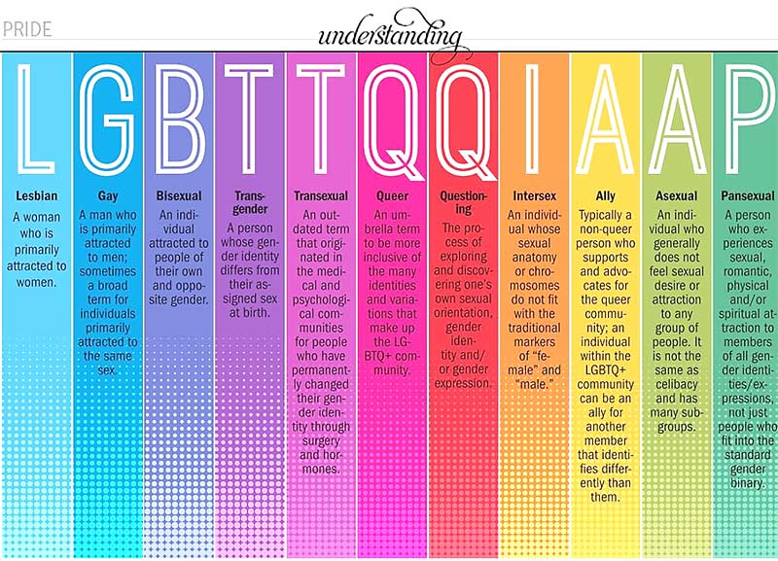

Slide 9
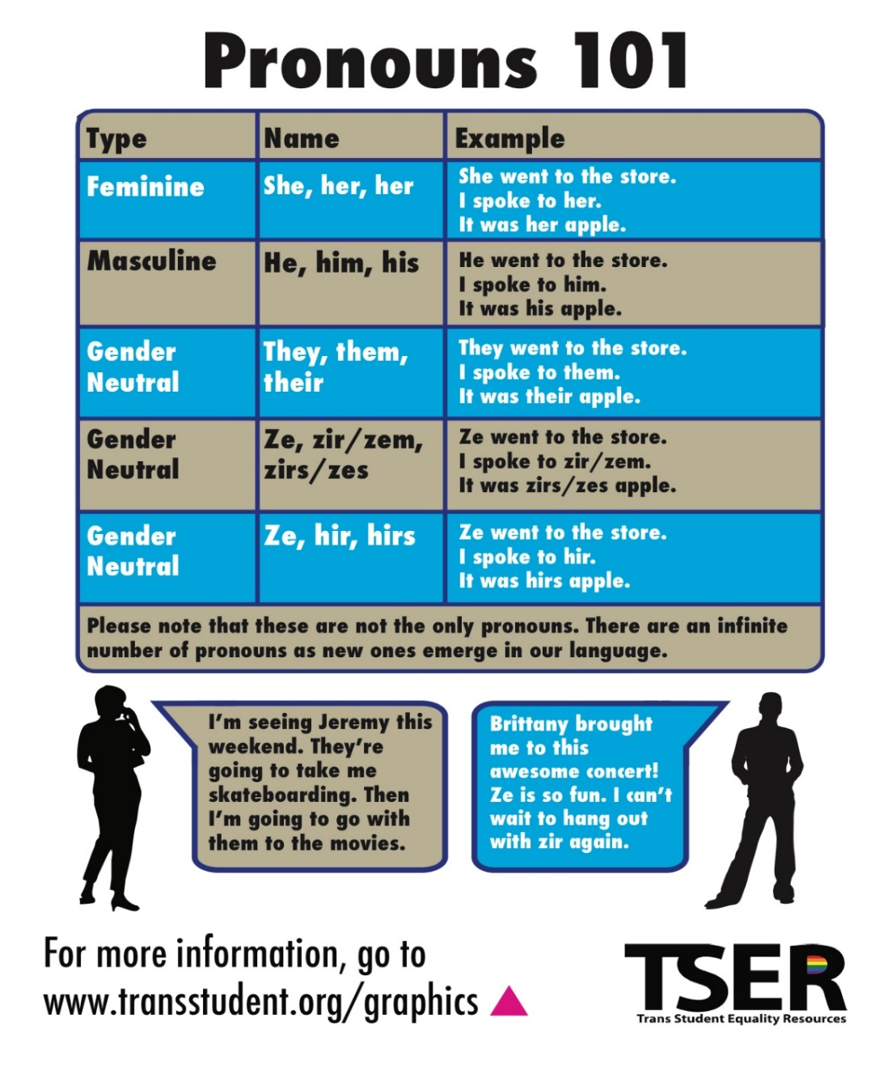
Pronouns
People may use a range of pronouns, including she/her/hers and he/him, his, as well as less-common pronouns such as they/them/theirs and ze/hir/hirs (pronounced zee/hear/hears.)

Slide 10
Recovery Facts
Recovery is an up and down process.
Symptoms may remain but people still recover.
Recovery from the consequences of being ill is often harder than recovering from the illness itself.
Recovery: A process by which a person with a disability regains their self-esteem, dreams, self-worth, pride, choice , dignity and meaning. Pat Deegan 2006

Slide 11
What is Recovery?
A process by which an individual with a disability recovers their self-esteem, dreams, self-worth, pride, choice, dignity and meaning (P. Deegan 2006)
The action or process of regaining possession or control of something stolen or lost.
A process of change through which individuals improve their health and wellness, live a self-directed life, and strive to reach their full potential. (SAMHSA.GOV)
SAMHSA’s Working Definition of Recovery

Slide 12
Where we apply recovery……
“Providers are in a key position to make a difference. Their attitudes can either help or hinder the recovery process. Their influence directly impacts the way a person conceptualizes their recovery journey.” Lori Ashcroft, Ex. Dir of the Recovery Opportunity Center at Recovery Innovations
Our entire service system is built on a strength based, recovery-oriented foundation. From intake, to transition to discharge planning, recovery touches every aspect of a person’s treatment and care.

Slide 13
What contributes to recovery?
Environment where services are provided.
Staff interaction with person and families served.
Media/educational materials.
Peer Support
Individual plans of service
Services offered: Supported Employment, Outpatient Counseling, Consumer-Run groups, etc…
Self- Determination
Discharge/Transition planning

Slide 14
Community Influence on Recovery
Communities have a profound influence on each person’s recovery process.
A community can create an environment of hopefulness that promotes recovery.

Slide 15
What is a Peer Support Specialist?
Peers have a unique background and skill level from their experience utilizing services and supports to achieve their personal goals of community membership, independence and productivity.
Peers have the special ability to gain trust and respect from beneficiaries based on their own experience and perspective navigating human service systems.
Peers help consumers move into more active assistance and away from passive patient roles and identities, and to build and/or enhance self-esteem, and self-confidence.

Slide 16
Role of the Peer Support Specialist (PSS), in Recovery
The Peer Support acts as a liaison within the agency between the consumer and the clinician.
The PSS is able to assist the Clinician/Case Manager in many areas of the treatment plan.
  Vocational assistance
  Housing assistance
  Services and supports planning and utilization assistance: person centered planning, self-determination, sharing stories of recovery and/or advocacy involvement, accessing entitlements, wellness plans (WRAP), advance directives, alternatives to guardianship.

Slide 17
How does staff interaction affect a person’s recovery?
Fact: SAMSHA ADS Center 2007 study Improving Provider Attitudes and Practices toward People with Mental Illness, consumers of mental health services were asked “Who discriminated against you?” 21% of the people answered, Mental Health System.
The way we talk, body language and behaviors affect how a person we serve will react to treatment. On the next few slides you will see examples of stigmatizing behavior.
(Information obtained from Combating Stigma within the Michigan Mental Health System, A Toolkit for Change)

Slide 18
People First Language
Focus on the individual, not their disability
Put people first, not their disability
Emphasize abilities, not limitations
Do not sensationalize a disability by saying “afflicted with”, “victim of”, “suffers from”
Portray successful people with disabilities as successful people, not super humans
Be accurate in describing disabilities

Slide 19
How does the agency setting affect a person’s recovery?
Imagine the last visit you made to a doctor’s office for a personal matter. How did the following affect your thoughts, feelings or personal levels of comfort.
Accessibility: location, sufficient space for person’s utilizing wheelchairs or walkers, parking, sidewalks free of snow or other obstacles, availability of interpreters (Limited English Proficiency).
Accommodations: front desk interaction, privacy, bathrooms in the waiting room, coffee, television, magazines, educational materials, décor or toys for children.
Building Maintenance: bright areas, clean walls and flooring, trimmed grass etc…

Slide 20
You Know You’re Stigmatizing If You…
Feel a need to feel superior over someone.
Refer to someone by their diagnosis.
Refer to persons we serve as “difficult” or “non-compliant.”
Use words like crazy, psycho, loony, etc…
Make assumptions about the person.
Discourage persons we provide services to, from pursuing their goals until after their symptoms have subsided.
Treat persons we provide services to differently than other staff, including your speech and body language.
Do not promote prevention, early intervention and wellness programs.
Are not making information on health benefits available and easily accessible.
Treat persons we provide services to rudely or less important.
(Information obtained from Combating Stigma within the Michigan Mental Health System, A Toolkit for Change)

Slide 21
How does media or educational material contribute to a person's recovery?
Education and learning is a key factor in helping a person to understand what may be happening in their life, at that particular time. Dispelling myths and providing facts and hope is an integral part of our job with Community Mental Health. Recognizing that each person learns differently and sometimes written educational material may not benefit a person.
Providing consumers with opportunities to participate in groups or other activities within the community is necessary.
Updated information in the lobby and waiting areas keeps people interested.
Many television stations and websites provide information on mental illness, developmental disabilities and health and wellness.

Slide 22
HOW DOES MEDIA OR EDUCATIONAL MATERIAL CONTRIBUTE TO A PERSON'S RECOVERY? – CONT.
How does social media effect the way a person reacts or responds? The positives of social media posts are they bring attention to matters that were once hushed or forbidden. They also provide another outlet for people to receive education about topics they wouldn’t typically research. Networking and making connections through social media is also a growing trend that has been very beneficial. Friends and family often know where we work, but may not understand our roles or have misconceptions of the jobs we do. The negative side of social media posts could be what you’re posting regarding personal feelings towards work. Ask yourself before posting, would a person who receives services be offended by this statement? Does your comment contribute to stigmatizing attitudes about the people we service?

Slide 23
Stigma Reduction, What YOU can do...
Examine your own attitudes and beliefs toward individuals with mental illness.
Use person-first language: use terms such as a person with mental illness, not a mentally ill person. For example, a person with bi-polar disorder is not “a bi-polar.”
Address issues relevant to stigma in case conferences, team meetings and supervision.
Support hope and potential for recovery.
Shift our emphasis from psychopathology and symptoms to improving lives.
(Information obtained from Combating Stigma within the Michigan Mental Health System, A Toolkit for Change)
“Mental illness is nothing to be ashamed of, but stigma and bias shame us all.”
-Bill Clinton

Slide 24
What YOU Can Do – Cont….
Support the integration of peers into your agency’s workforce and the availability of consumer-run programming.
Look for opportunities to educate colleagues, staff, and other agencies about persons served to reduce stigma.
Implement a “no wrong door” approach to customer service that encourages persons served and families to reach out for help. Be open and welcoming to persons served who have questions about their finances and benefits.
Include persons served and family members on committees charged with improving the quality of the agency
Admit when you are wrong.
(Information obtained from Combating Stigma within the Michigan Mental Health System, A Toolkit for Change)
“Stigma is prejudice wrapped in shame, born of ignorance, and fed by our fear.”
-Barbara Lawton, Former Lieutenant Governor of Wisconsin

Slide 25
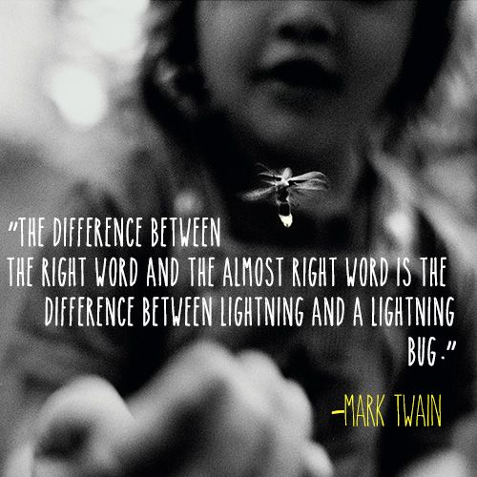

Slide 26
Recovery & The Individual Plan of Service
When working with a person there are a few things that we can remind ourselves of, to make treatment person centered and recovery focused.
Every setback is an opportunity for growth.
Empathy and compassion for life struggles of individuals we serve underlie effective treatment.
Change and growth are possible throughout the life cycle.
Supporting peers in the treatment process means that a person is not alone in their recovery journey.
(Information obtained from SAMSHA, Addiction Counseling, Competencies: The knowledge Skills, and Attitudes of Professional Practice.)
“…to change a system, it has to change from focusing on our illness and disability, to focusing on our strengths.”
-Larry Fricks, Director of the Appalachian Consulting Group

Slide 27
Recovery & The Individual Plan of Service – Cont….
Recovery does not only evolve in the community, but also in the mental health system.
The healing process is complex, involving psychological, social and physical attitudes
Peers enhance the recovery process.
Policies and treatment promote the person’s potential for recovery and flourishing.
Accept, reflect and seek to understand an individual’s history of trauma.
Good clinicians meet the person where they are on their recovery journey.
Resilience and recovery evolve differently for each person.
Optimism with all individuals is a positive key in assisting them in their recovery process.
(Information obtained from SAMSHA, Addiction Counseling, Competencies: The knowledge Skills, and Attitudes of Professional Practice.)
“What you think of yourself because you have a mental illness can often be more disabling than the illness itself.”
-Ike Powell, Director of Training, Appalachian Consulting Group

Slide 28
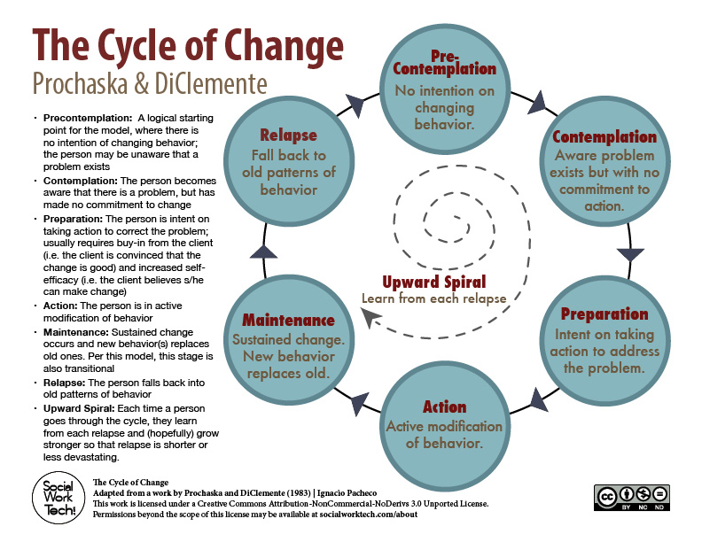
Stages of Change Model

Slide 29
Stages of Change Model
The Transtheoretical Model of Behavior Change assesses an individual's readiness to act on a new healthier behavior and provides strategies or processes of change to guide the individual through the stages of change to action and maintenance.
Clinician is meeting the person where they are.
Understanding that a person may move many times within the model depending on their personal life and what is happening (nonlinear).
A person may be in several stages at once, as typically life hands us different problems at one time.

Slide 30
Services that support recovery
Psycho-Education
Health Education
Individual, Family, Group Treatment
Pharmacological
Case Management
Primary Health Care Physician
Community Resources
Referral to Human Service Agencies
Peer Support
Community Living Supports
Collaboration
Discharge and Transition planning
(Strength Based, Recovery Oriented, Stage-wise Treatment, Mark Lowis, LMSW, MINT, President MML Consulting)

Slide 31
Self Determination and Recovery
Self-determination is the value that people served by the public mental health system must be supported to have a meaningful life in the community. The components of a meaningful life include work or volunteer activities that are chosen by and meaningful to person, reciprocal relationships with other people in the community, and daily activities that are chosen by the individual and support the individual to connect with others and contribute to his or her community. With arrangements that support self-determination, individuals have control over an individual budget for their mental health services and supports to live the lives they want in the community. The public mental health system must offer arrangements that support self-determination, assuring methods for the person to exert direct control over how, by whom, and to what ends they are served and supported.

Slide 32
Discharge/
Transition Planning and Recovery.
Planning begins at intake. We begin to talk about transition, to the least restrictive care or discharge when the person served or guardian identifies their desired outcomes.
Please review the copy of the HBH discharge and transition plan: Discharge and Transition.pdf
“Innumerable confusions and a feeling of despair invariably emerge in periods of great technological and cultural transition.”
Marshall McLuhan

Slide 33
September 12, 2011|By Jeannine Stein, Los Angeles Times / For the Booster Shots blog:
People suffering from depression may not bring it up with their doctor for several reasons, a study finds. The most common one? They're afraid of getting a recommendation for antidepressants.
Those findings are featured in a study released in the journal Annals of Family Medicine. In it, researchers surveyed 1,054 adults about why they wouldn't tell their primary care physician about depression symptoms, as well as their beliefs about the mental disorder. Depression symptoms, the study authors note, are underreported.

Slide 34
Among the participants, 43% reported one or more reasons why they wouldn't discuss symptoms with a doctor. The most common obstacles to not reporting symptoms were the prospect of being put on medication, the belief that it's not the doctor's job to handle emotional issues and worries over medical record privacy. At least 10% of the participants said that fear of being referred to a counselor or psychiatrist and being branded a psychiatric patient were stumbling blocks.
Those who had more barriers to talking to their doctors about depression had some things in common: They were likely to be female, Hispanic, with less education and lower income. Other factors included the severity of depression symptoms, having no family history of depression, thinking depression is stigmatizing, and believing that people should be able to control their depression.
"Ironically," the authors wrote, "those who most subscribed to potential reasons for not talking to a primary care physician about their depression tended to be those who had the greatest potential to benefit from such conversations--individuals with moderate to severe depressive symptoms."

Slide 35
Limited English Proficiency (LEP)
Limited English Proficiency or, “LEP” is defined as the inability to speak, read, write or understand English at a level that allows effective interaction with Community Mental Health staff.
Important Points-
Treat every consumer as a consumer, regardless of his/her ability to speak English.
Discrimination does not need to be intentional to be illegal. Agencies have a clear legal obligation to avoid it.
LEP compliance is a legal obligation based on a history of several laws, regulations and court decisions.
Title VI of the Civil Rights ACT of 1964 requires that no person shall be subjected to discrimination based on race, color or national origin under any program or activity that receives federal financial assistance.
The courts have determined that discriminating against a person based on language is the same as discriminating against them based on nationality. We receive federal financial assistance; therefore, we are bound by the LEP standards.

Slide 36
Legal Basis for LEP
The Americans with Disabilities Act (ADA) provides the legal basis for LEP standards applying to those with poor eyesight or hearing impairments. Additionally, many other federal laws recognize the need for language assistance such as the:
    Older Americans Act
    Substance Abuse and Mental Health Administration Reorganization Act
    Rehabilitation Act of 1973
    Our responsibilities are further clarified by a wide variety of federal regulations including the Center for Medicare and Medicaid Services.

Slide 37
Legal Basis cont..
Provide language assistance at no cost to LEP persons.
Do not suggest, expect, or allow minors, other consumers, or relatives to act as an interpreter-even to make an appointment unless consent was given by the consumer.
Exception- the exception to this rule is in case of an emergency.

Slide 38
Document
Clearly document any assistance when you believe that circumstances warrant use of an interpreter.
Document every occasion when a friend or family member of the consumer is used as an interpreter. Did the consumer make the decision, after being clearly informed that they have a right to FREE language assistance?

Slide 39
LANGUAGE ASSISTANCE
People whose primary language is not English and have limited ability to understand, speak, read and write English have the right to receive benefits and treatment in their language of preference at no cost to them.
Contact Customer Services if you need assistance contacting Language Line Services – Jenni Sweet- 906-635-3707
Contact Language Line Services directly by calling:
1-888-808-9008 use pin #34242308 and state the language needed. An interpreter will be connected.

Slide 40
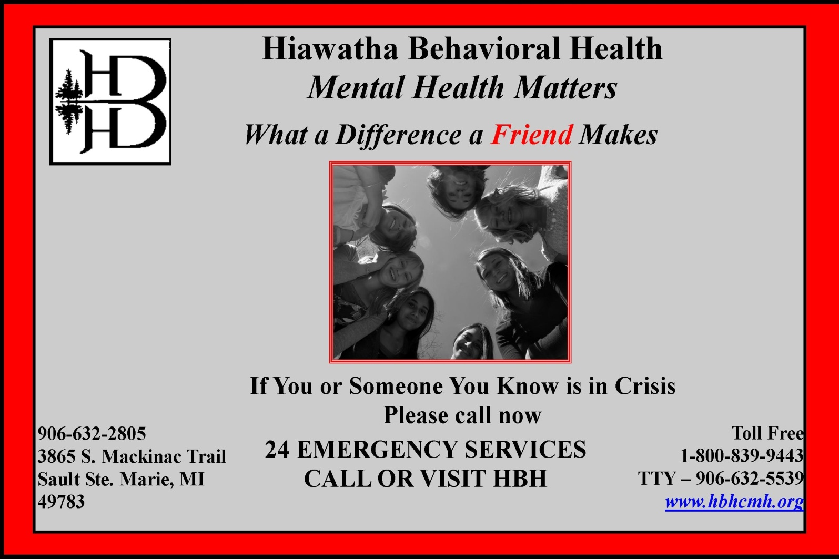
Expect Recovery!

Slide 41
Test
Upon closing this window, you will be taken to the test.

